Slide 1
DDS – For Live Session Unit 2
Andrew Leppla
*See Notes section below slides for R code

Slide 2
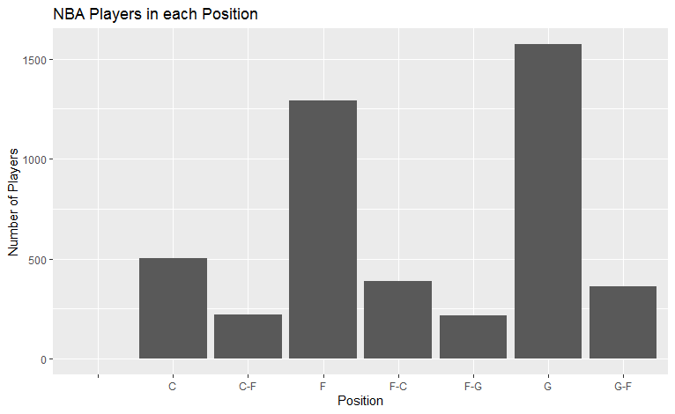
Problem - Use the PlayerBBall.csv dataset to visually represent (summarize) the number of players in each position.
Notes:
library(ggplot2, magrittr)
bball = read.csv('C:/Users/aleppla/Documents/Andy - Personal/MS DataSci/MSDS 6306 - Doing Data Science/Unit 2/PlayersBBall.csv')
bball %>% ggplot(aes(x=position)) + geom_bar() + ggtitle("NBA Players in each Position") + ylab("Number of Players") + xlab("Position")

Slide 3
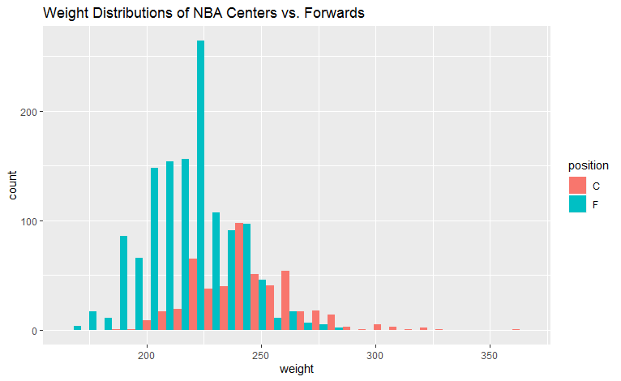
Centers appear to have a marginally greater weight distribution than Forwards in the NBA, but this is likely not significant due to the major overlap in the distributions
Notes:
#Attempt just using ggplot, can't get “dodge” to work, used facet_wrap for side-by-side instead
ggplot() + geom_histogram(data=bball[bball$position=="C",], aes(x=weight,fill="Center")) +
geom_histogram(data=bball[bball$position=="F",], aes(x=weight,fill="Forward")) + facet_wrap(~position)
#Subsetting and recombining data frames for C and F. Can now use “dodge” to overlay side-by-side
C = bball[bball$position=="C",]
Fw = bball[bball$position=="F",]
C_Fw=rbind(C,Fw)
C_Fw %>% ggplot(aes(x=weight, fill=position)) + geom_histogram(position="dodge") + ggtitle("Weight Distributions of NBA Centers vs. Forwards")

Slide 4
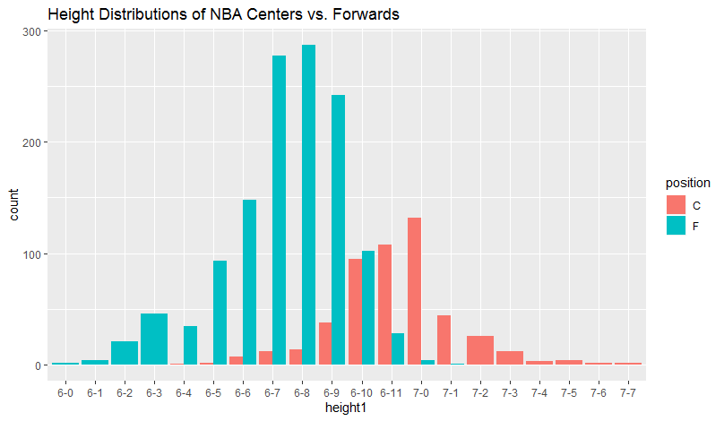
Centers appear to have a greater height distribution than Forwards in the NBA, although there is some overlap between them.
Notes:
#Need to reorder the height factor levels with -10, -11 to go after -9 instead of -1
##https://www.r-bloggers.com/reorder-factor-levels/
levels(bball$height)
bball$height1=factor(bball$height, levels(bball$height)[c(1,4:9,2:3,10:11,14:21,12:13,22:29)])
levels(bball$height1)
C = bball[bball$position=="C",]
Fw = bball[bball$position=="F",]
C_Fw=rbind(C,Fw)
C_Fw %>% ggplot(aes(x=height1, fill=position)) + geom_bar(position="dodge") + ggtitle("Height Distributions of NBA Centers vs. Forwards")

Slide 5
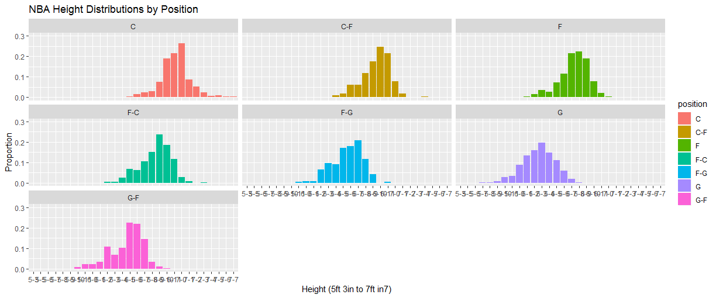
Height distributions appear to be different for some positions in the NBA. The shortest are Guards and the tallest are Centers, as expected.
Notes:
bball[bball$position!="",] %>% ggplot(aes(x=height1, y=..prop.., group=1, fill=position)) + geom_bar() +
facet_wrap(~position) + coord_cartesian(ylim = c(0, 0.3)) + ggtitle("NBA Height Distributions by Position") +
xlab("Height (5ft 3in to 7ft 7in)") + ylab("Proportion")

Slide 6
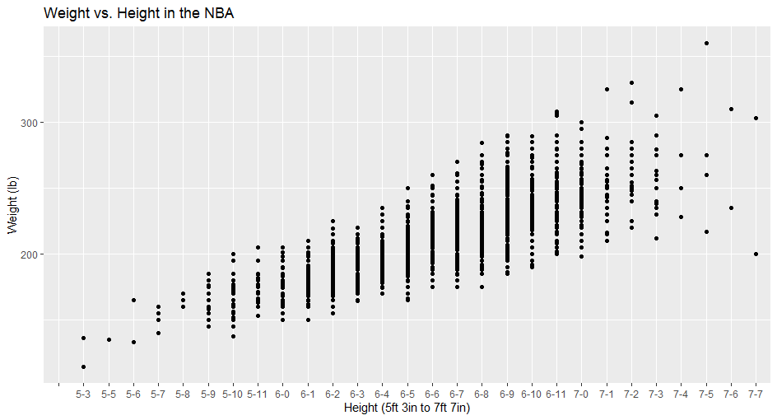
Weight and height are positively correlated – as height increases, weight increases, and vice versa
Notes:
bball %>% ggplot(aes(x=height1, y=weight)) + geom_point() + ggtitle("Weight vs. Height in the NBA") +
xlab("Height (5ft 3in to 7ft 7in)") + ylab("Weight (lb)")

Slide 7
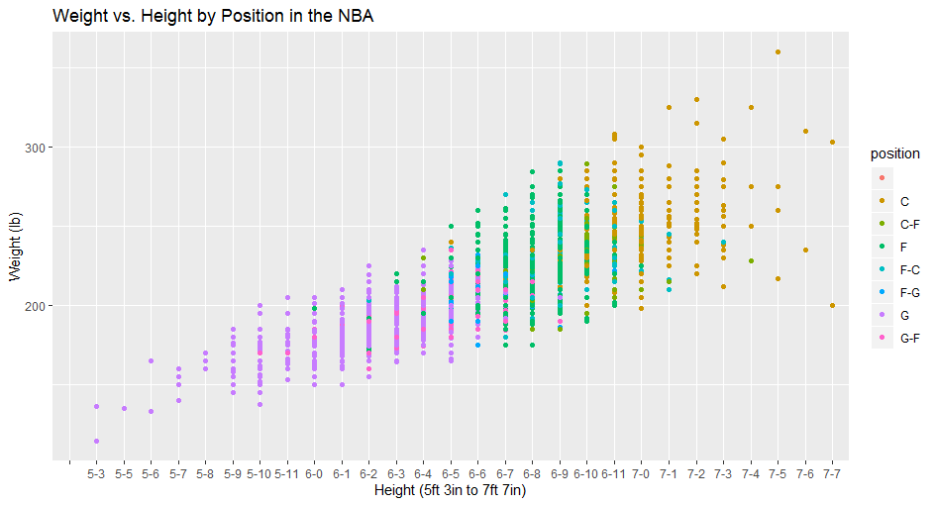
Centers do not follow the weight vs. height trend (flatter line)
Notes:
bball %>% ggplot(aes(x=height1, y=weight, color=position)) + geom_point() + ggtitle("Weight vs. Height by Position in the NBA") +
xlab("Height (5ft 3in to 7ft 7in)") + ylab("Weight (lb)")

Slide 8
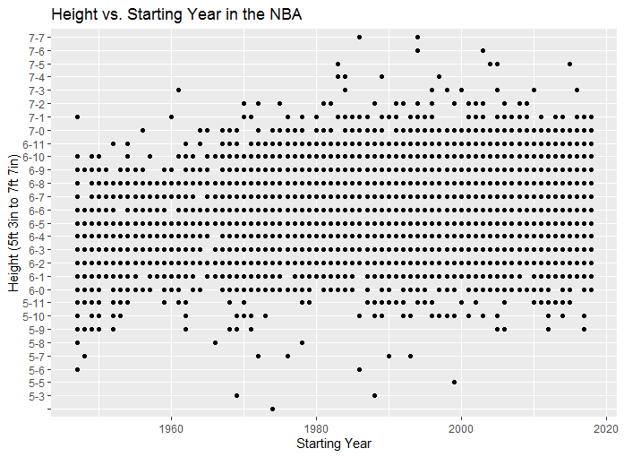
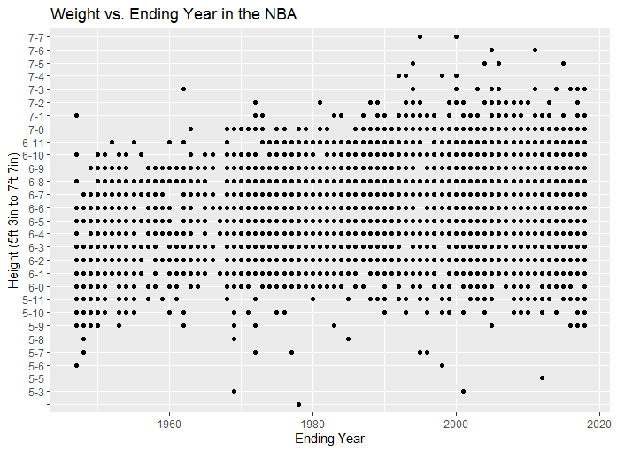
No evidence to suggest that NBA players are getting taller over time
Notes:
bball %>% ggplot(aes(x=height1, y=year_start)) + geom_point() + ggtitle("Height vs. Starting Year in the NBA") +
xlab("Height (5ft 3in to 7ft 7in)") + ylab("Starting Year") + coord_flip()
bball %>% ggplot(aes(x=height1, y=year_end)) + geom_point() + ggtitle("Weight vs. Ending Year in the NBA") +
xlab("Height (5ft 3in to 7ft 7in)") + ylab("Ending Year") + coord_flip()

Slide 9
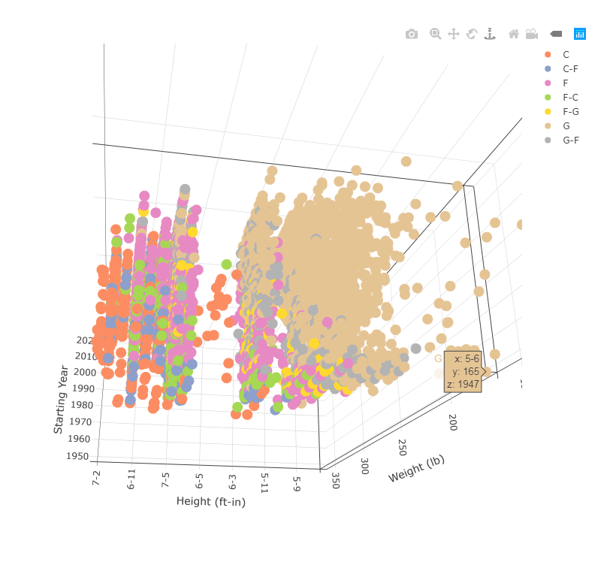
Create a 3D plot of height vs. weight vs. year and color code the points by position.

Slide 10
Go to this website and use one of the 50 best plots to visualize some aspect of the data and provide at least one insight

Slide 11
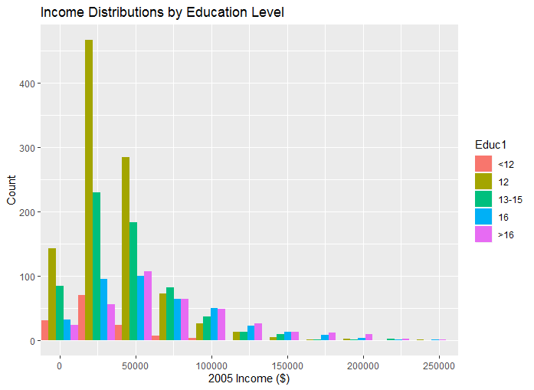
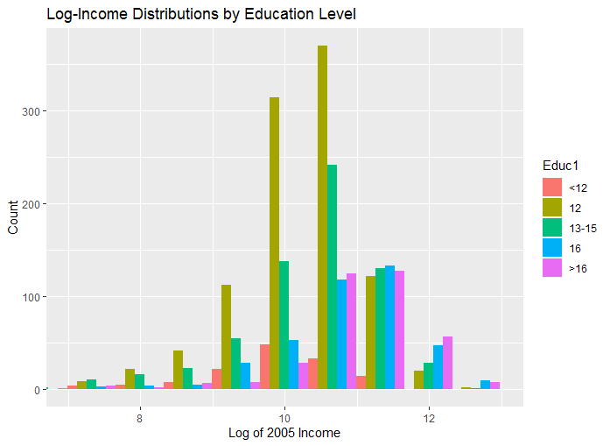
Median income appears to increase with Education Level

Slide 12
Takeaways and Questions
Takeaways
Rstudio’s viewer/browser didn’t work with plotly 3D plots. Troubleshooting this was time consuming but educational and I now have easy workarounds.
The maps package in R is awesome!
Questions
Is there a way to plot histogram distributions in ggplot with proportion rather than count? The only thing I could find was geom_density which smooths the distribution. There may be something buried in the stat option as well that I didn’t see.

